Slide 1
Naval Institute National University “Odessa Maritime Academy”
“ Tantum possumus, quantum scimus ”
Notes:
1

Slide 2
Завдання Інститут
Implementation of cadets at the first and second levels of higher education for further service in the positions of officers in order to meet the needs of the Armed Forces of Ukraine and other military formations formed in accordance with the laws of Ukraine.
Carrying out educational activities in order to ensure higher and postgraduate education, to meet other educational needs of cadets.
Implementation of professional orientation of youth and selection of candidates for training at the Institute from among civilian youth and servicemen of the Armed Forces of Ukraine.
Full and high-quality execution of the state order for training of military specialists, international agreements on training of military specialists of foreign states.
Educating a deep sense of love for Ukraine and its people, forming the necessary professional qualities and psychological readiness to defend the Ukrainian state with weapons in hand, developing a creative attitude to learning and a high culture of behavior among students.
Carrying out of scientific activity by carrying out of scientific researches and maintenance of creative activity of participants of educational process, use of the received results in educational process.
Development and implementation of educational programs for the training of military specialists.
Notes:
2

Slide 3
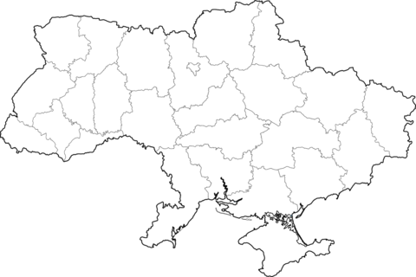
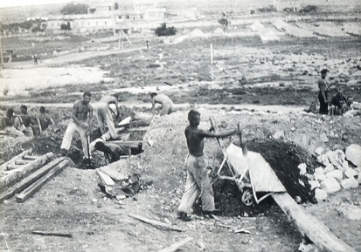
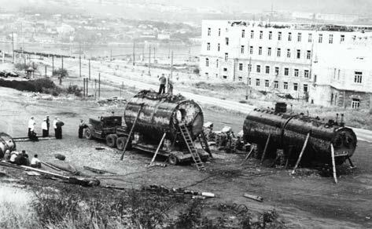
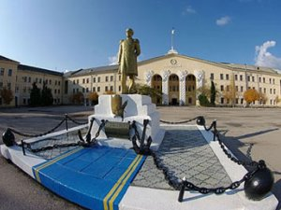
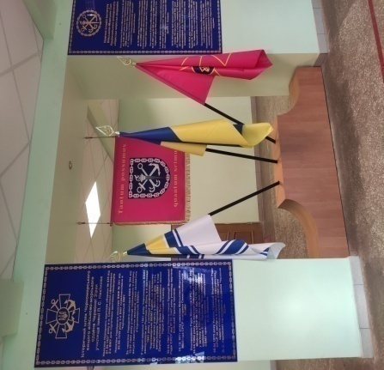
Історична довідка
1937 - in Sevastopol formed the Second Naval School for the training of watch commanders
1939 - The second naval school was renamed the Black Sea Naval School
1952 - in connection with the 150th anniversary of the birth of Admiral PS Nakhimov, the Black Sea Higher Naval Academy was awarded the honorary title of PS Nakhimov
1992 - the Sevastopol Naval Institute was established on the basis of the Black Sea Higher Naval School named after PS Nakhimov and the Sevastopol Naval Engineering School.
2009 - Sevastopol Naval Order of the Red Star Institute named after PS Nakhimov reorganized into the Academy of Naval Forces named after PS Nakhimova.
2014 - As a result of the annexation of the Autonomous Republic of Crimea and the city of Sevastopol in the spring of 2014, the Nakhimov Naval Academy was liquidated and reformed into the Faculty of Naval Forces of the Odessa Naval Academy National University.
2016 - presentation of the battle flag by the Minister of Defense of Ukraine POLTORAK Stepan Tymofiyovych. The Faculty of Naval Forces of the National University "Odessa Naval Academy" was reorganized into the Institute of Naval Forces of the National University "Odessa Naval Academy"
Notes:
3

Slide 4
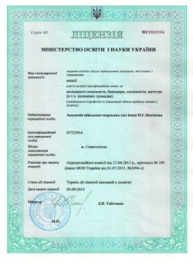
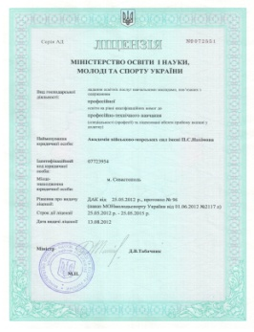
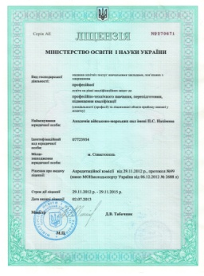
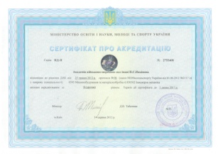
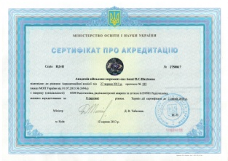
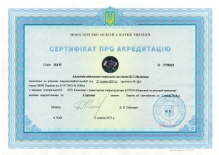
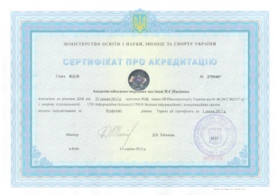
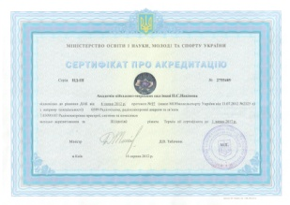
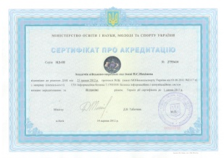
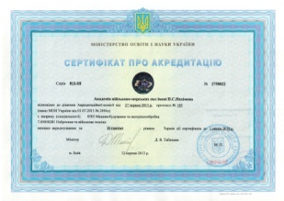
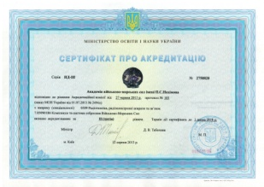
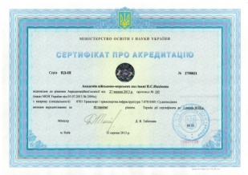
Accreditation of the Institute
License of the Ministry of Education and Science of Ukraine
License from 05.2012 series АD №2072551
License from 11.2012 series АЕ №2270671
License from 07.2013 series АЕ №2285204
Certificates of the Ministry of Education and Science of Ukraine Accreditation from 06.2012, Specialty :0505, 6.050502
Accreditation from 06.2012, Specialty :1701, 7.17010101
Accreditation from 06.2012, Specialty :1701, 6.170101
Accreditation from 07.2012, Specialty :0509, 7.0509013
Accreditation from 07.2013, Specialty :0505, 7.05050281
Accreditation from 07.2013, Specialty :0509, 6.050901
Accreditation from 07.2013, Specialty :0509, 7.05090186
Accreditation from 07.2013, Specialty :0509, 7.05090182
Accreditation from 07.2013, Specialty :0701, 6.070104
Accreditation from 07.2013, Specialty :0701, 7.07010401
Accreditation from 07.2013, Specialty :0701, 7.07010402
National Agency for Quality Assurance in Higher Education Certificate of Accreditation №821, Specialty : 254
Certificate of Accreditation №822, Specialty : 255
BUREAU VERITAS Certification Holding SAS - UK Branch
Certification ISO 9001:2015 №UA229675
Certification ISO 9001:2015,IDT №UA229676
Notes:
4

Slide 5
STRUCTURE
Оrganization of the Institute of Naval Forces of the National University "Odessa Maritime Academy"
 |  |  |  |  |  | INSTITUTE COMMAND
 |  |  |  |  |  | Headquarters
 |  |  |  |  |  | Departments
Navigation |  |  | Weaponry |  |  | Energy |  |  | Social Sciences Humanities and Fundamental disciplines |  |  | All-military disciplines |  |  | Language training
Division of training boats |  |  | Tactics of the Navy |  |  | Research Center of the Armed Forces of Ukraine “State Oceanarium” |  |  | Physical training and sports |  |  | College of officer training
 |  |  |  |  |  | Divisions
 |  |  | Retraining and advanced training courses |  |  | Courses foreign languages |  |  | Educational courses |  |  | Material and technical support |  |  | Information and telecommunication
Notes:
5

Slide 6
EDUCATION ACTIVITIES
Specialty | Specialization
Bachelor`s
254 Implementation troops (forces) | Moral and psychological support
 | Search and rescue and diving and emergency work at sea
255 Weapons and military equipment | Ship`s radio weapons and means of communication
 | Ship power plants
 | Ship`s weapons and navigation aids
 | Coastal missile and artillery armament
Master`s
255 Weapons and military equipment | Ship`s radio weapons and means of communication
 | Ship power plants
 | Ship`s weapons and navigation aids
271 River and sea transport | Moral and psychological support
 | Search and rescue and diving and emergency work at sea
Notes:
6

Slide 7
Training courses
commanders of navigating combat units of surface ships;
commanders of missile-artillery and mine-torpedo combat units of surface ships;
commanders of radio technical combat units and combat units of surface ships and shore units;
commanders of electromechanical combat units of surface ships;
heads of services of radiation, chemical and biological protection and ecological safety;
specialists (specialists) in providing and conducting light diving works;
specialists (specialists) on issues of moral and psychological support in the Naval Forces of the Armed Forces of Ukraine;
ship commanders, senior assistants and assistant commanders of surface ships;
officers of the headquarters of naval bases, divisions of surface ships;
specialists (specialists) in the management of small craft;
mine and torpedo officers;
officers of coastal missile artillery troops;
specialists in assessing the bodies of military management of military units (subdivisions) of the Naval Forces of the Armed Forces of Ukraine for the acquisition of certain operational, combat, special capabilities.
Notes:
7

Slide 8
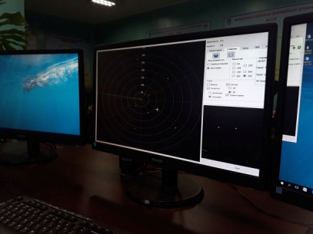
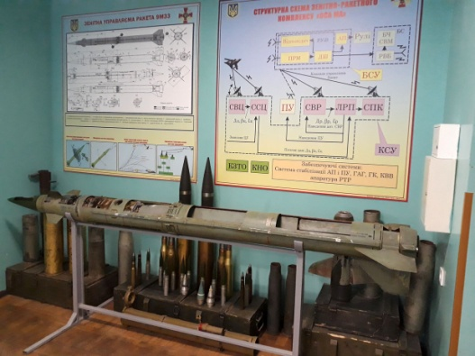
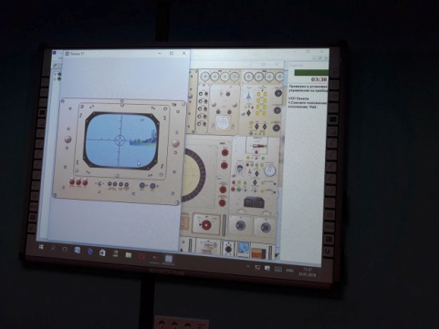
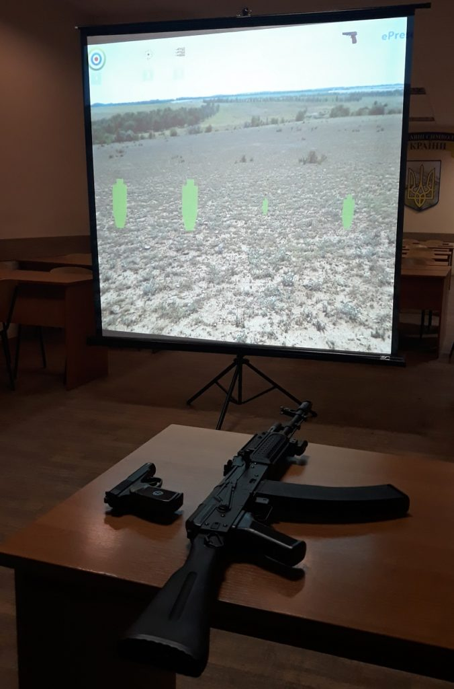
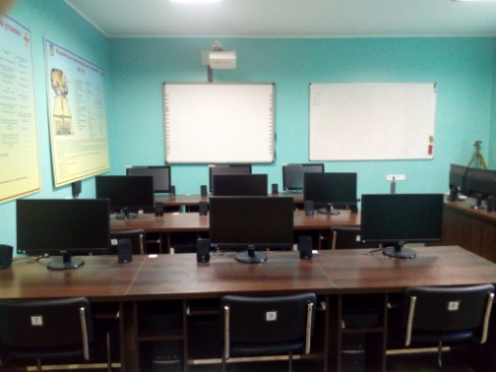
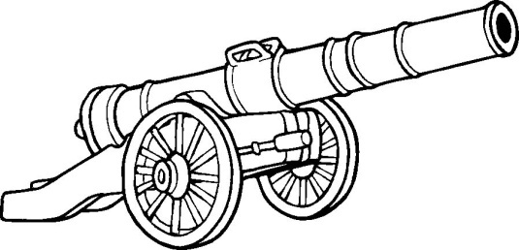
Training facilities
Department of Armaments
Simulator MR 123 “VYMPEL”
- Simulator “radar P18”
- Simulator “KAMAZ “
- “AIS”
- Recognition system simulator
- ECDIS software
Notes:
8

Slide 9
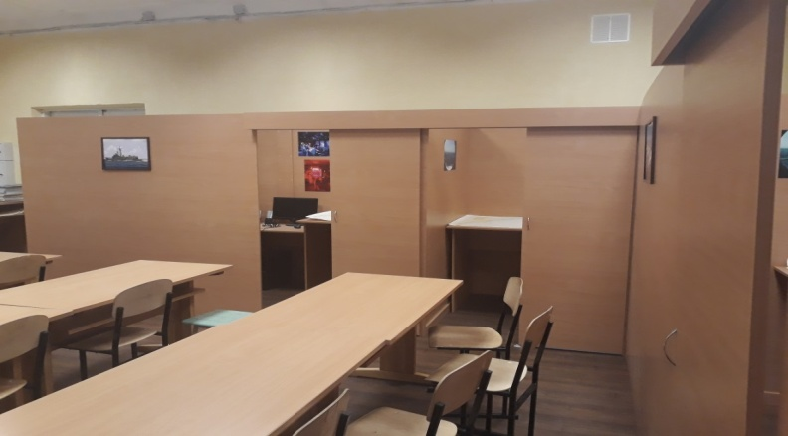
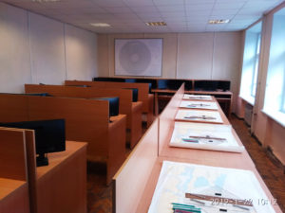
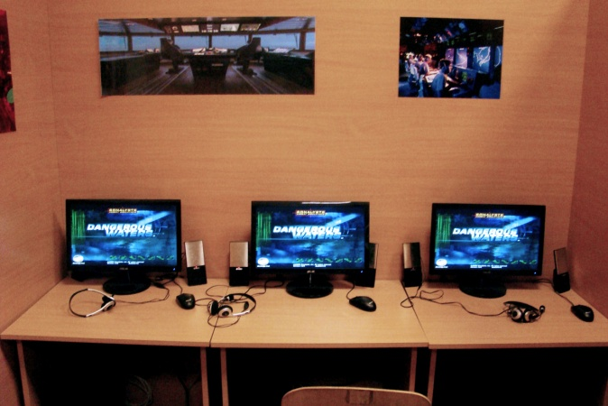
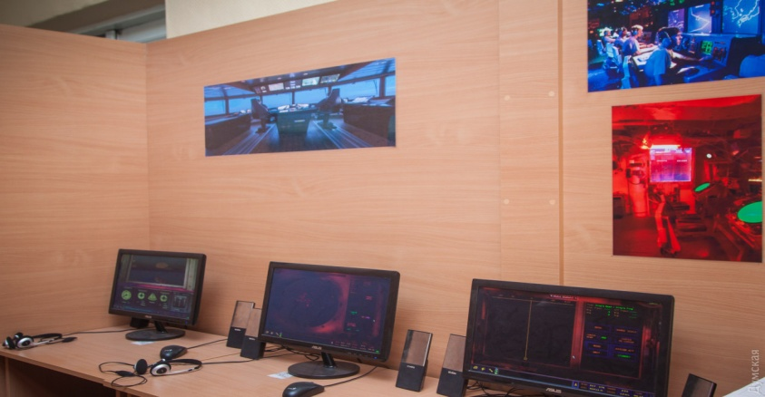
Training facilities
Department of Navigators
- Simulator “DANGEROUS WATERS”
- Simulator “NT PRO 5000”
Notes:
9

Slide 10
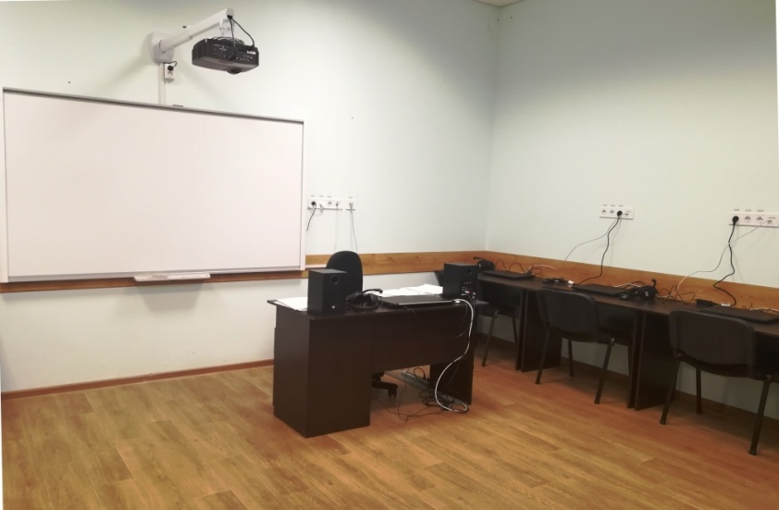
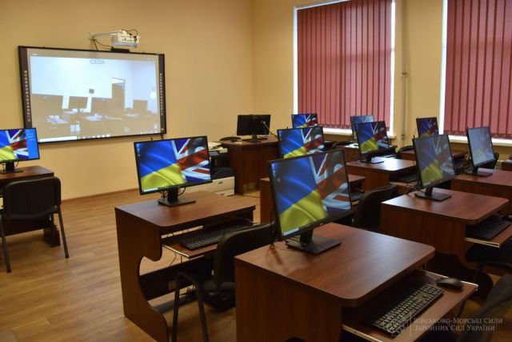
English language classes
1. The intensive English language course has been conducted for the 1st year cadets (180 hours);
2. STANAG certification for the English course graduates as well as officers/cadets;
3.Opened a third language classroom.
Notes:
10

Slide 11
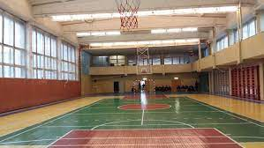
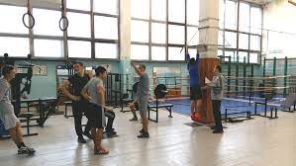
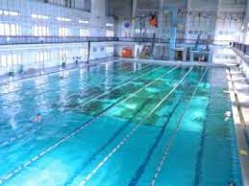
Sports complex
Gym
Basin
Gym hall
Notes:
11

Slide 12
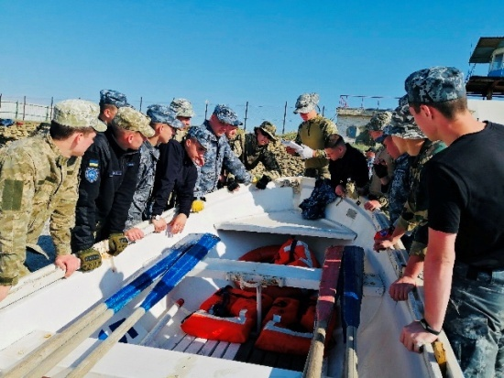
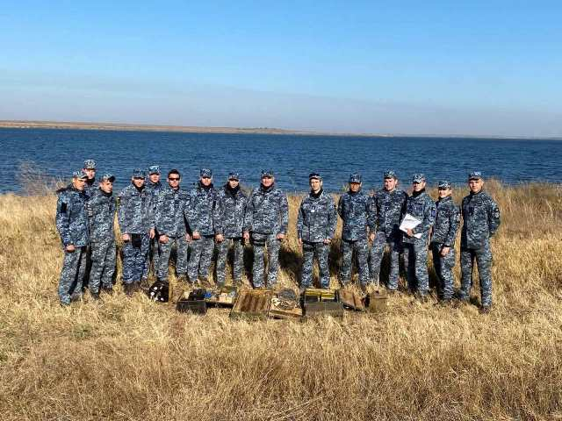
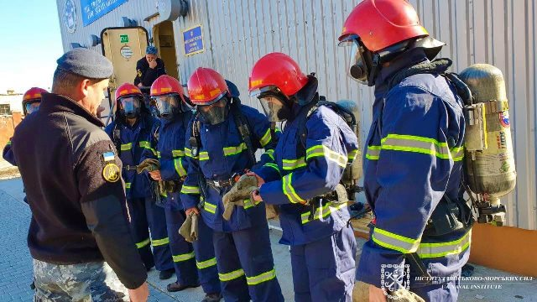
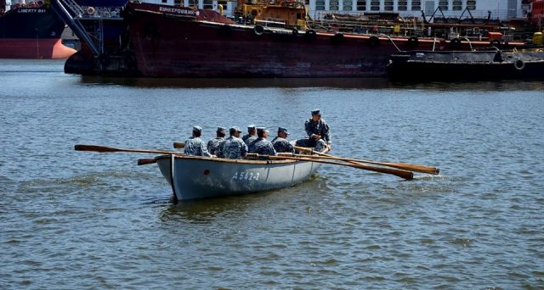
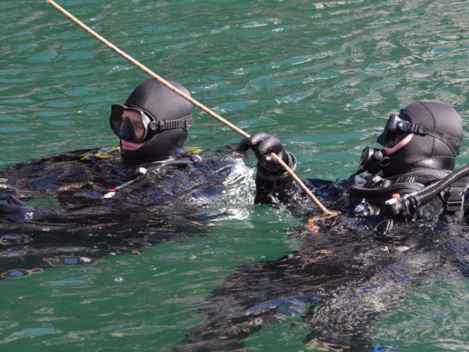
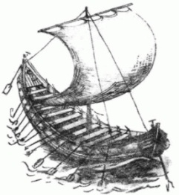
Practice
1. Internship on Navy ships
2. Passing the course "Struggle for survival"
3. Practical classes at sea for divers
4. Courses of underwater welding EO Paton Institute
5Field exit (training) counteraction to underwater saboteurs
6. Boating practice
7. Leadership courses
8. Practice at the Coastal Missile Complex
Notes:
12

Slide 13
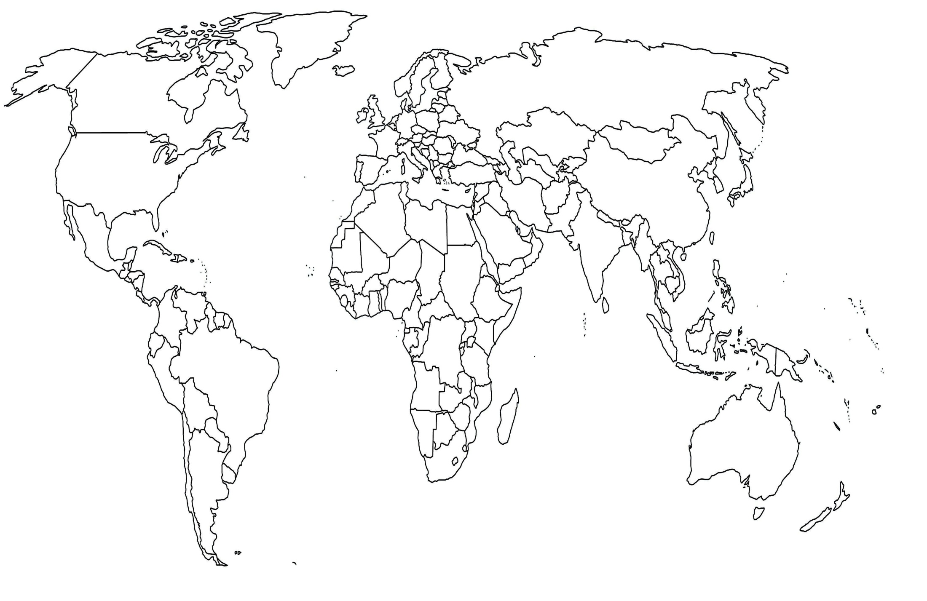
INTERNATIONAL MILITARY COOPERATION 2021
Military establishments:
1.Royal Naval College “Britania” - 3
I2.talian Naval Academy – 2
International delegation:
1. Visit of advisers between the Ministerial Program for Peace and Stabilization for Ukraine (2022-2025)
2. Visit of representatives of the coordination group NATO DEEP
3. Visit of delegation of the Commander of Romanian Navy
4. Visit of the international committee of the Red Cross «Humanitarian law and planning during hostilities».
5. Visit of representatives of the training operation”UNIFIER”
6.Visit of the Ambassador of the French Republic.
7.Visiting the Academy «140th anniversary of NVNA»
8. Participation in international exercises ”Sea Breeze exercise”
Courses/exercises/conferences:
1.Franch language courses – 8 cadet
2.E-instructor certification programme
(FFDP1) 1 “Student Centered Active Learning Methods”
3.Online course of the Bulgarian Navy Academy to improve English
4.Naval Academy Foreign Affairs Conference
(NAFAC 2021)
5.22nd European Naval Academies Superintendents Conference (ENASC)
“Week NATO”
Notes:
13

Slide 14
Tantum possumus, quantum scimus
Notes:
14

